Slide 1

LA Clippers DATA Analytics Intern Data Challenge
SAI SAATHVIK DOMALA

Slide 2
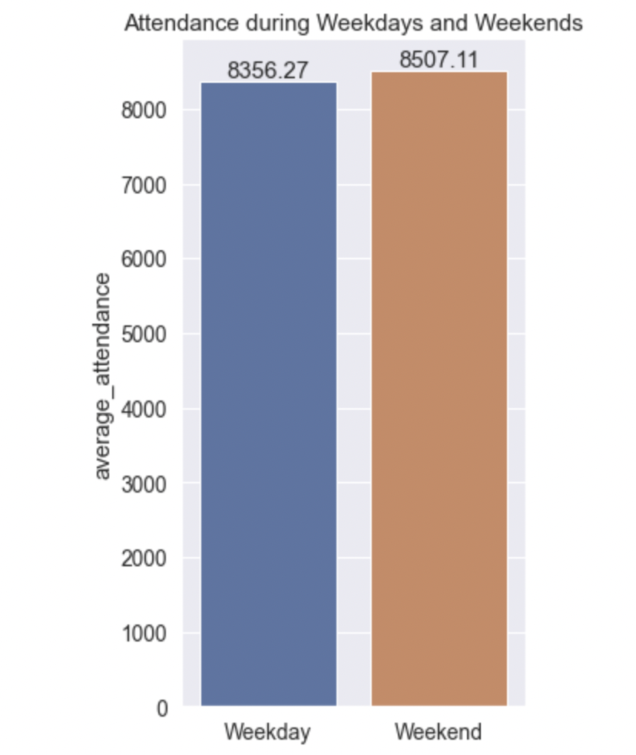
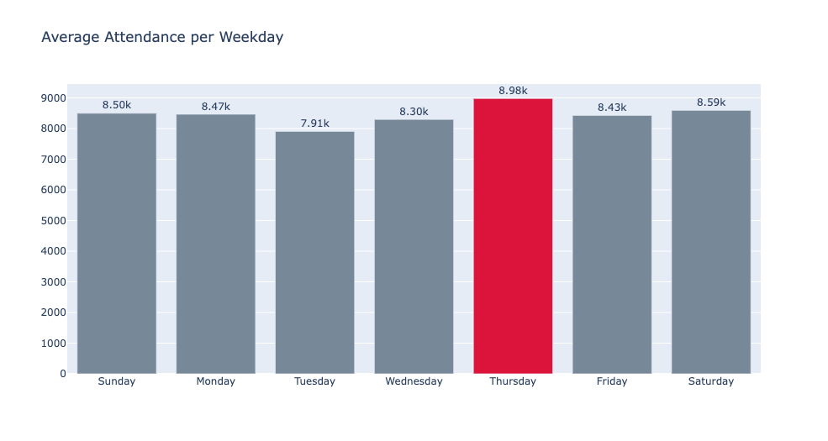
Insight 1: Attendance throughout the Week
Though attendance on Weekends are higher than Weekdays, surprisingly, Thursdays experience the highest attendance.

Slide 3
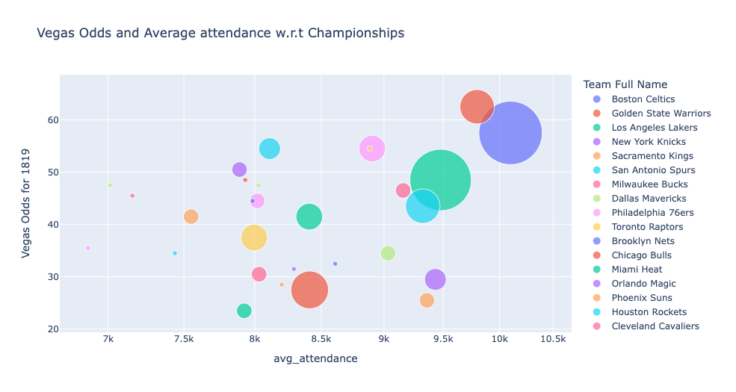
Insight 2: Vegas Odds VS Avg Attendance VS Championships
More fans would attend a game if the opponent team is considered a “good” team.
Golden State Warriors, LA Lakers and Boston Celtics are among one of the few “popular” teams
While teams with no championships(on the left) experience lower attendance even though they may have decent Vegas Odds.
The ”good” factor is solely based on the number of championships and Probability of winning for that season

Slide 4
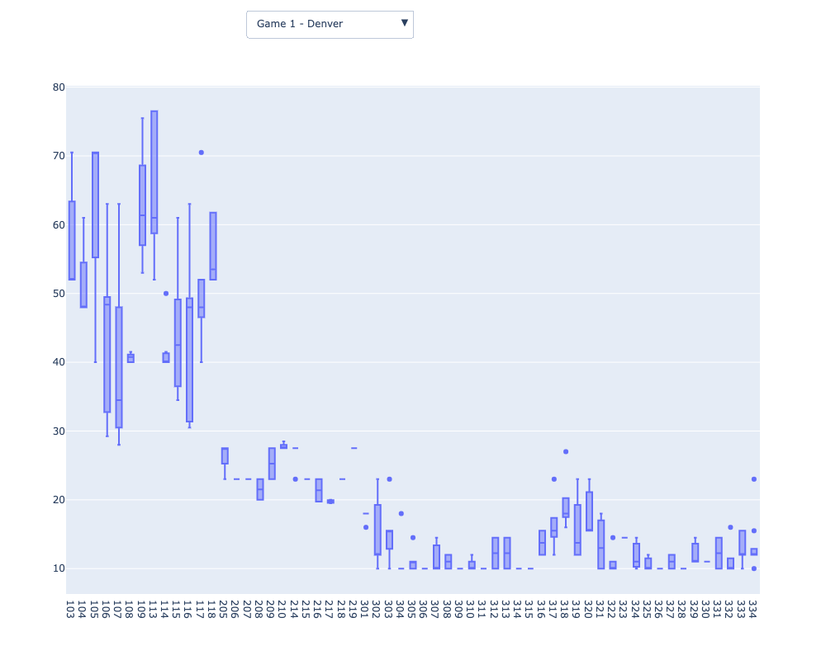
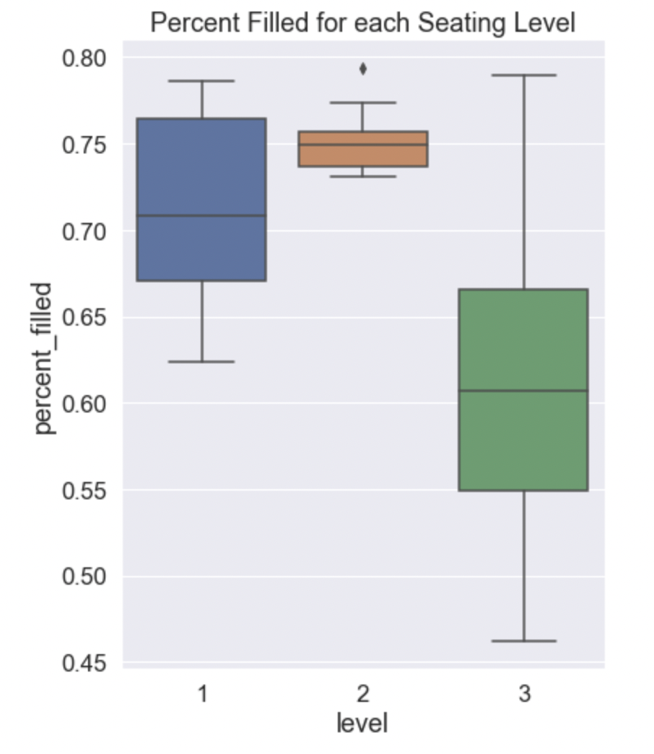
Insight 3: Dropdown Boxplot for Section VS Price
We can see that Level 1 is usually more priced since it has a closer view.
The boxplot on the left shows the distribution of prices for every game for every section.

Slide 5
DATASET
For creating a model to predict the 2019-2020 season average attendance, I scraped data from several sources. There are 3 main insights that are essential for prediction of attendance for a season:
Team Statistics: Usually, more people would watch a game if the team is considered to be playing well that season. Therefore, it is important to incorporate team statistics for every season.
Data Source: https://www.basketball-reference.com/teams/LAC/
2) Ticket Price: Prices of a tickets are another important factor that play a role in encouraging fans to attend games. Most of time, so called "bad teams" have cheaper tickets to encourage more fans into attending games. If ticket prices are expensive, it usually means there is more demand.
Data Source : https://seatgeek.com/los-angeles-clippers-tickets
3) Average Attendance: The most important factor which is to be predicted by the model is the average attendance for every season.
Data Source: https://data.world/gmoney/nba-team-annual-attendance

Slide 6
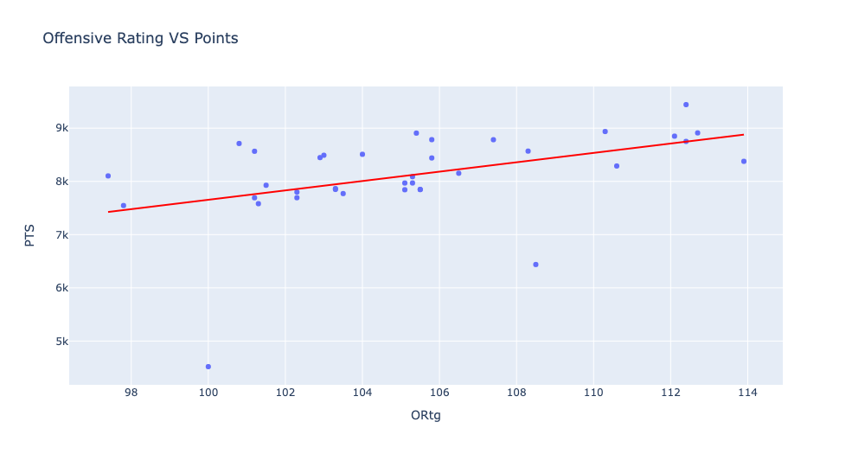
Visualization 1: Offensive Rating VS Points
The higher the average team score, the better is their offensive rating.

Slide 7
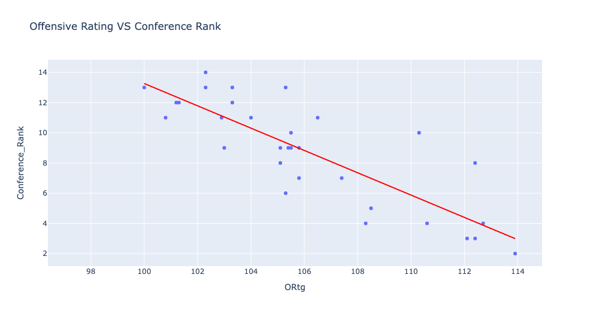
Visualization 2: Offensive Rating VS Conference Rank
Again, Higher offensive Rating shows a higher Conference Rank.

Slide 8
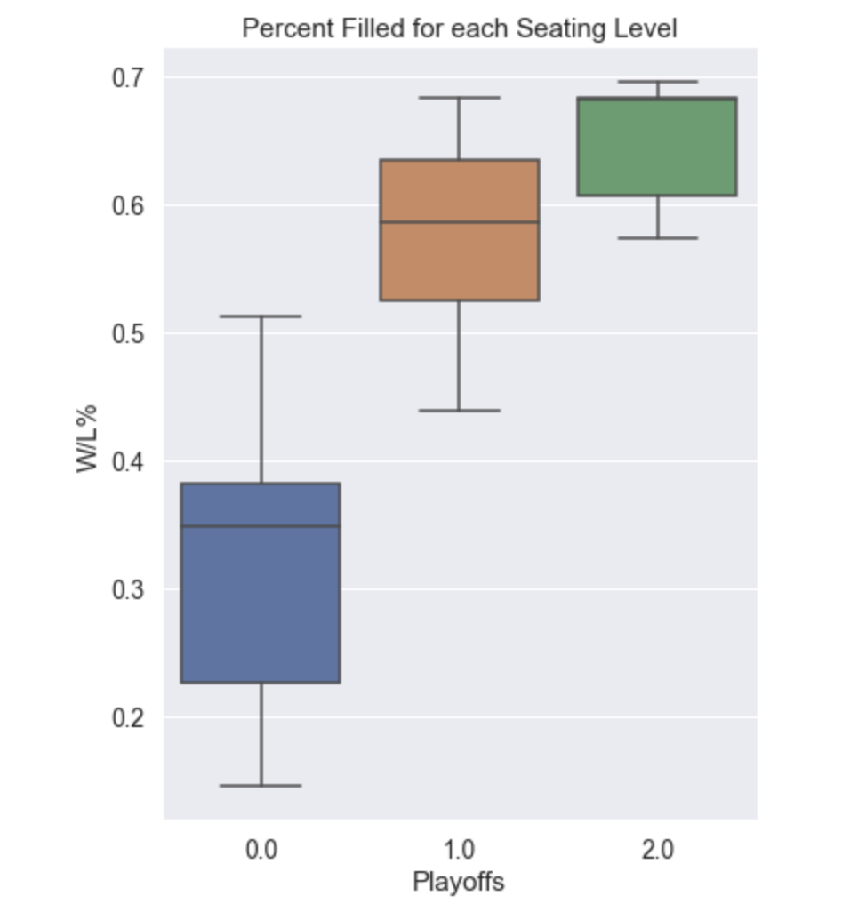
Visualization 3 : Playoffs Round VS W/L%
If a team has been consistently winning and has a higher W/L%, they would usually get further in the Playoffs
Unqualified
Lost WC 1st Rnd
Lost WC Semis

Slide 9
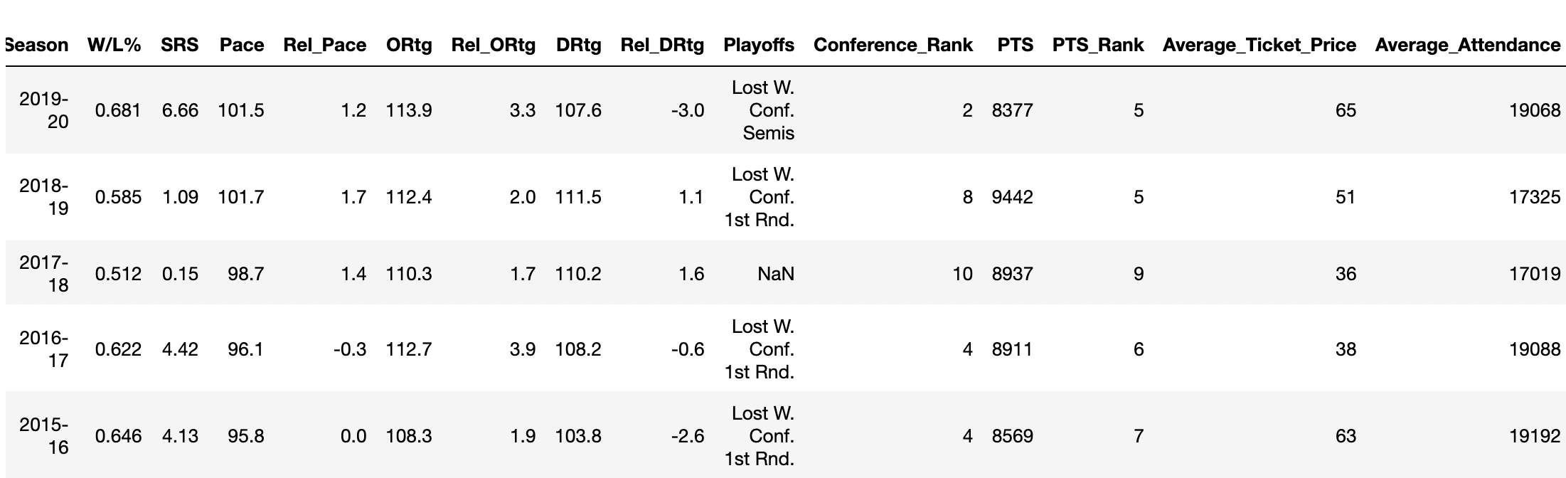
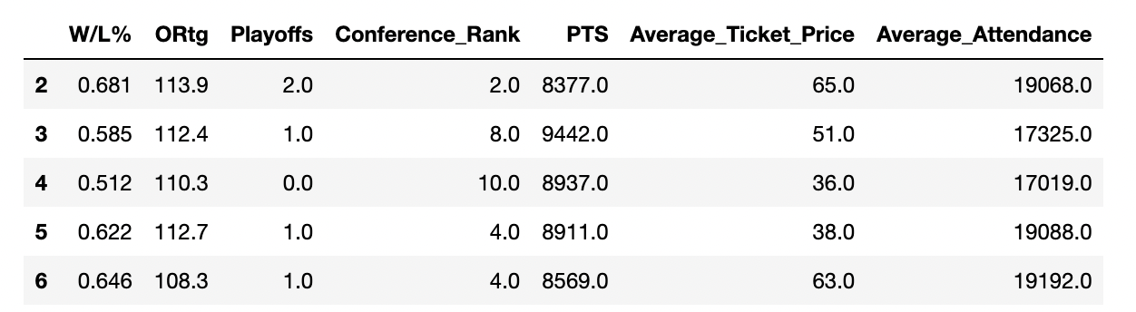
Dataset
Before Feature Selection
After Feature Selection

Slide 10
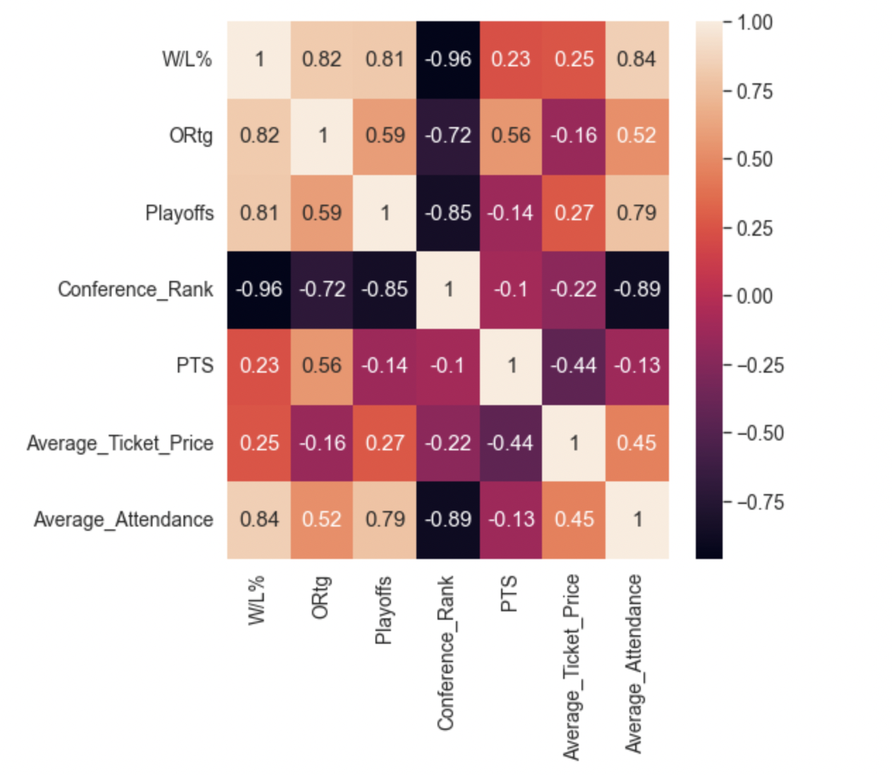
Correlation Heat Map
This Correlation Map shows how each feature impact another feature.
Positive Correlation indicates that increase the value by 1 unit, increases the corresponding feature by some positive factor.
Here we see, Average Attendance is positively affected by W/L%, ORtg, Playoffs, Avg_Ticket_Price.

Slide 11
RESULTS
1) Linear Regression
Prediction VS True Value
Goodness-of-fit measure - R2 score

Slide 12
RESULTS
2) Decision Tree
Prediction VS True Value
Error in Prediction

Slide 13
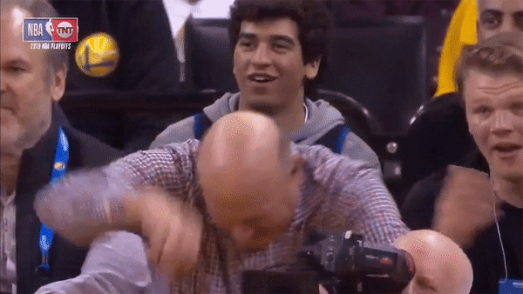
EVEN STEVE BALMER IS HAPPY WITH THE ACCURACY!!!

Slide 14

THANK YOU

